Slide 1


Neptune: The Israeli Consortium for Network Programming
Concluding Demo
Yaakov (J) Stein
chair

Slide 2

Welcome
Presenter: Avi Gal (Gilat)

Slide 3



















ברוכים הבאים
להדגמת מאגד נפטון

Slide 4



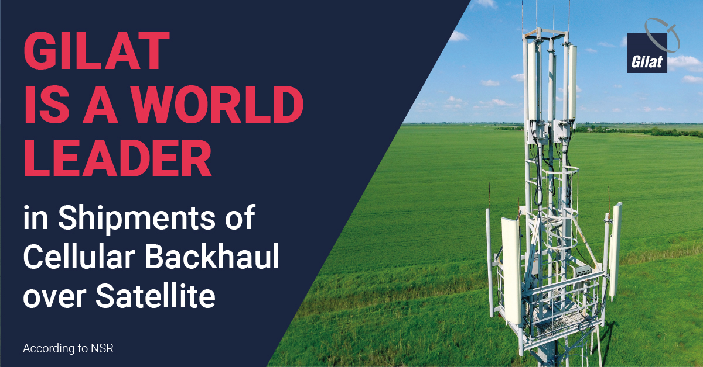
גילת ונפטון
טכנולוגיות הכרחיות ברשתות הלוויין הנוכחיות והעתידיות
  SDN/NFV, MEC, LSO, Orchestration, Dynamic resource allocation, Cloud based infrastructure, Network Programmability
יתרונות טכנולוגיים שכבר הביאו הצלחות מסחריות ושיתופי פעולה טכנולוגיים

Slide 5
Introduction
Presenter: Yaakov Stein (RAD, Neptune chair)

Slide 6

Agenda
14:00 Welcome + demo overview
14:20 Machine learning demos
14:40 Zero touch provisioning demo
15:00 CORD demo
15:20 Self healing demo
15:40 P4 and Sampling on Demand demo
16:00 Neptune summary
16:20 Multi-operator Multi-technology Service Creation demo
16:40 Network Slicing demos
17:00 Concluding remarks
17:10 Academic presentations

Slide 7
Demo Participation
Machine Learning Rad+ADVA
FACEaaS ADVA+ASOCS+Partner+Ceragon
Zero-Touch Provisioning BATM+Rad
CORD Elbit+ASOCS+Partner+Gilat
Self-healing Elbit+ASOCS+Partner
Satellite Self-healing Gilat
P4 and Sampling on Demand Mellanox+Technion
Multi-operator Multi-technology Service Creation ECI+Gilat+Ceragon
Microwave and Satellite HetNet Slicing Ceragon+Elbit+Gilat
Cellular Network Slicing ASOCS+Partner

Slide 8

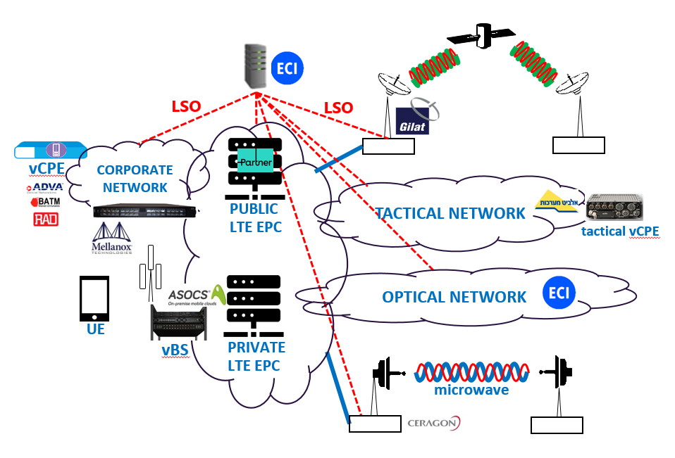
What will we see today?
We will present a series of demos
demonstrating that we achieved our aims
These demos will involve
7 interconnected networks
6 technologies
corporate network / Internet
optical network (ECI)
microwave links (Ceragon)
satellite links (Gilat)
tactical network (Elbit)
public 4G network (Partner)
private 4G network (ASOCS)

Slide 9


Look at what just arrived!
A messenger just arrived with a brand new vCPE
The customer, who is not a networking expert,
will connect up the boxes
without waiting for a technician to visit
and it will all work automagically
We’ll see what happens later ...

Slide 10
Machine Learning – Bot Cleaner
Presenter: Andrew Sergeev (ADVA)

Slide 11

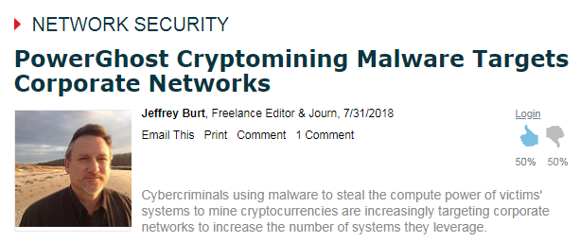
Motivation
NFVI platforms today predominantly based on x86 architecture CPUs.
Last year many CPU-specific vulnerabilities have been reported, some of them might allow to an attacker to obtain root privileges and to plant malware.
NFVI platforms create new attack surface
Notes:
Few articles mentioned new trends in the malware targets, one of them is stealing CPU cycles for crypto mining ‎[1]:
"In general, the evolution of crypto miners, like with most other malware, is moving towards reducing visibility [fileless technology], long-term gaining in the systems and obtaining additional income"
So, we must cope with a ‘stealth’ malware, which does not live traces in file system. This makes file scanning for malware detection irrelevant.
If we can’t inspect encrypted customer traffic and we can’t scan file for modern file-less malware, what other options we have for attack detection on NFVI platform? Here we evaluate sideband channels KPIs applicability for this task.
Sideband channels reflect CPU behaviour via various KPI. Using side-band channels for anomaly detection is proposed for example at ‎[4]

Slide 12
Cache depletion attack
Compute Node
vCPU
vCPU
Shared Cache
vCPU
vCPU
L3 Cache
L3 Cache
vRouter
vMiner
vhost-us
vhost-us
OVS-DPDK
dpdk0
dpdk1
client
VLC Server
Notes:
Technology background:
This block diagram shown stat-of-the-act NFVI scenario:
Client receives the traffic from VLC server,
The traffic is forwarded by vRouter, hosted by "Compute Node" or NFVI element.
x86 CPU with Hyperhreding shares Last-Level Chache between two CPU cores (threads).
Noisy neighbour takes CPU resources such as CPU cycles and CPU Cache thus reducing performance of legitimate application. The below picture illustrates Cache depletion attack for NFVI. One VM is legitimate VNF vRouter and second VM is malware (vMiner). We can see two configurations: in one L3 Cache (aka LLC or Last-Level-Cache) is shared between two vCPU processes and in 2nd also vCPU (CPU thread) is shared between two virtual machines.

Slide 13
Cache+CPU depletion attack
Compute Node
vCPU
vCPU
vCPU
vCPU
Shared Cache + vCPU
L3 Cache
L3 Cache
vRouter
vMiner
vhost-us
vhost-us
OVS-DPDK
dpdk0
dpdk1
client
VLC Server
Notes:
Noisy neighbour takes CPU resources such as CPU cycles and CPU Cache thus reducing performance of legitimate application.
The below picture illustrates Cache depletion attack for NFVI. One VM is legitimate VNF vRouter and second VM is malware (vMiner). We can see two configurations: in one L3 Cache (aka LLC or Last-Level-Cache) is shared between two vCPU processes and in 2nd also vCPU (CPU thread) is shared between two virtual machines.
This case is also relevant when a CPU does not support Hypersthreading or it is disabled.
CPU resource usage is visible via Intel-specific internal PM counters.

Slide 14


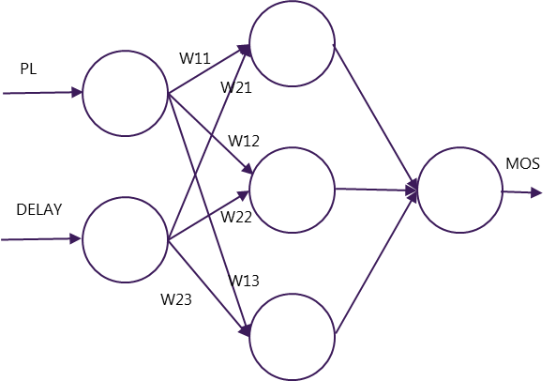
Use case: BOT Cleaner for hostile SW
BOT Cleaner
An intruder compromised an edge-NFVI host by using a security flaws (e.g. Meltdown / Spectre)
  Then he uses the edge-device server resources for his own needs (e.g. Bitcoin mining…)
  The intruder try to hide his activity and act “below-the-radar”
We use Machine Learning (ML) tools to detect the malicious activity and to recover the server to the a healthy state
Notes:
Neptune scenario: we have Edge-NFVI platform. As shown in the picture, the platfrom hosts several VNFs: vRouter + vFirewall + vSBC.
An intruder compromised an edge-NFVI host by using a security flaws (e.g. Meltdown / Spectre)
How to breakin using x86 security flaws? It is out of scope ( e.g. : http://woshub.com/how-to-get-plain-text-passwords-of-windows-users/)
Assume that the malware is planted, no traces in file system etc.
Our goal is to detect the malware which in fact is not noisy neibghor, but rather stealth squatter.
Such malware is not intended for volumetric DDoS attacks.
In the demo we focus on detection of stealth malware, corrective action is for future study.
We use CPU sideband channels KPI available on x86 CPUs and ML for abnormal behavior detection.

Slide 15







ML Bot Cleaner setup
WebRTC Client
Laptop/Tablet/Phone
Partner EPC2
Media Server
eCPRI
Ethereum miner
Cyrus
BotCleaner
ProVMe
edge device
Grafana
Data router
Server
ProVMe metrics and Classifier\Anomaly Detector decision sent live
Notes:
Description of life demo.
Media server receives lo-res stream from CCTV (no point to send HD video over internet)
KPI collected from NID + CPU and ML detection results send to RAD’s Grafana server over the mobile network
On demand we activate/deactivate the “Etherium miner” container on CPE device
We can see the detection results on the remote Gafana server screen.

Slide 16

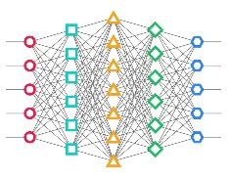
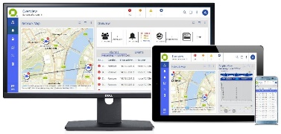




ML Bot Cleaner setup
KPI Data
Build the model
Predict using the learned model
Emulate intrusion using Kali

Slide 17
Machine Learning – FACEaaS
Presenter: Eyal Ben Saadon (ADVA)

Slide 18

Story: FACEaaS
FACEaaS lost child or terrorist
Message: VAF (Virtual Application Function)
using the same tools as NFV

Slide 19
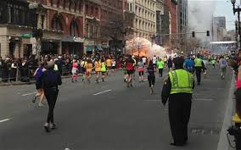
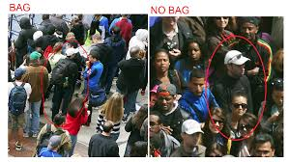
Face as A Service : The need
We all remember the Boston Marathon terror attack …
What if we could have given an alert or even prevented it … ?
But ubiquitous face recognition raises privacy concerns!
The solution – on-demand FaaS edge computation

Slide 20

Face as a Service
Lost-Child/ Find a Terrorist use-case: FACEaaS
A Child is lost
Mother applies for Find a Child service…
VM with FaceNet analytics is spin-out on the edge-compute devices on the child’s neighborhood/Last seen area
HD-Video is used for the analytics VM on the edge compute
LR-Video/monochrome is passed to the cloud Media-Server (so a user/mother can look at it)
FaceNet analytics results are also transmitted to the cloud and available for parents to verify that the child was found ☺
Service teardown
VAF (Virtual Application Function), using the same tools as NFV

Slide 21















Setup
Internet
FaceNet
D-NN
Media Server
vFirewall
vRouter
LTE up-link
LR-Video
stream
HD-Video
stream
LR-Video + Analytic
Remote
Radio Head
C-RAN + Virtual
eNodeB
Evolved
Packet Core
ADVA NID
hosting virtual appliances
Edge Compute / XG304u
Notes:
Lost-Child/ Find a Terrorist use-case: FACEaaS
A Child is lost.
Mother apply for Find a child service…
VM with FaceNet analytics is spin-out on the edge-compute devices on the child’s neighborhood/Last seen area
HD-Video is used for the analytics VM on the edge compute.
LR-Video/monochrome is passed to the cloud Media-Server (so a user/mother can look at it).
FaceNet analytics results are also transmitted to the cloud and available for parents to verify that the child was found. ☺
Service teardown.

Slide 22
What did we want to accomplish?
When we started Neptune 5 years ago, our vision included:
reduction of service setup time from months to minutes
automation of network operations, including
  zero-touch instantiation of network elements and services
  automatic resilience and self-healing
operational expense reduction of 50% or more
enabling completely new service types
building an Israeli ecosystem for the next generation of networking
In the past two years we extended these same goals for services:
  spanning multiple network operators (Lifecycle Service Orchestration)
  requiring an independent subnetwork (network slicing)

Slide 23
Zero Touch Provisioning
Presenter: Alon Geva (RAD)

Slide 24
Zero touch
Zero touch provisioning (ZTP) means automatically setting up
equipment (e.g., CPE)
end-to-end services (e.g., Point of Sale application for small business)
without human intervention
We saw CPEs delivered to customers
CPE runs ZTP process to boot and connect to its management system
VNFs are automatically installed and configured
CPE automatically connects to application (PoS at RAD HQ)
and it all works automagically

Slide 25



ZTP Process Ready to Plug & Play uCPE
CUSTOMER SERVICE ORDER
UPDATE
SHIPMENT ON
UCPE MANAGER
SHIP UNCONFIRMED WHITEBOX
PLUG
AND PLAY
PROVISIONING

Slide 26
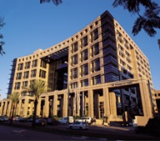
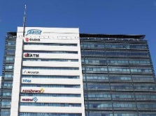


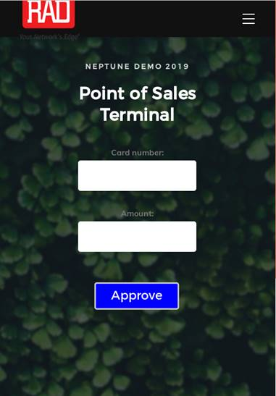
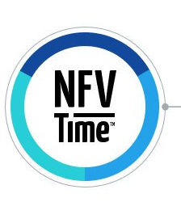


Zero touch
ZTP Configurator
ZTP bootstrap
server
RAD
Telco Systems
ZTP Configurator
ZTP
&
VPN to management
ZTP
&
VPN to management
Public
network
NFVi
-
OS
ETX-2v
uCPE
Device

Slide 27
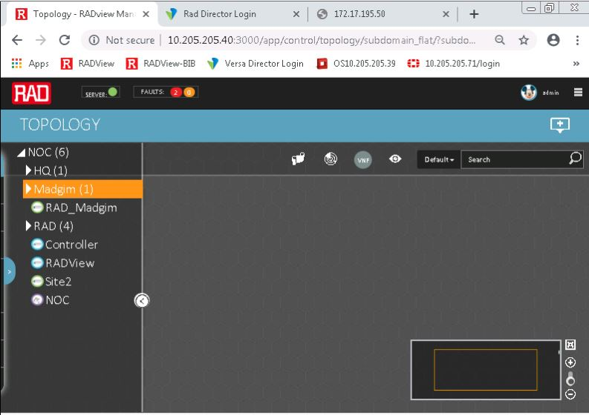
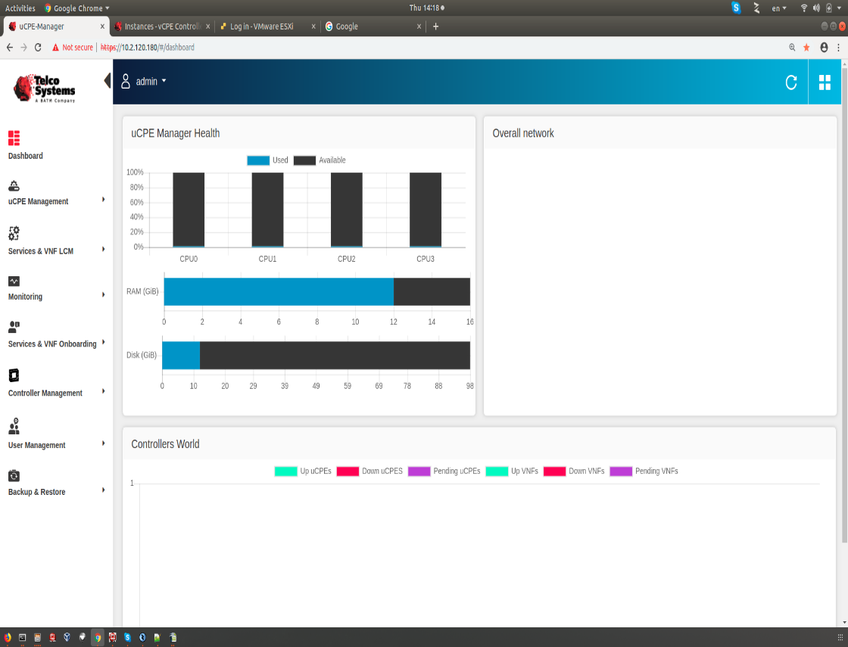
Network has no uCPEs or VNFs before ZTP
RAD
BATM

Slide 28
What did we want to accomplish?
When we started Neptune 5 years ago, our vision included:
reduction of service setup time from months to minutes
automation of network operations, including
  zero-touch instantiation of network elements and services
  automatic resilience and self-healing
operational expense reduction of 50% or more
enabling completely new service types
building an Israeli ecosystem for the next generation of networking
In the past two years we extended these same goals for services:
  spanning multiple network operators (Lifecycle Service Orchestration)
  requiring an independent subnetwork (network slicing)

Slide 29
CORD (MCORD-T)
Presenter: Zafi Kariv (Elbit)

Slide 30
Story: CORD
  כוחות הצלה מגיעים לאזור אסון
    בשלב הראשון מוקמת רשת טקטית המספקת שירותים לאזור הכיסוי באופן עצמאי ללא backhaul
      מודגמת יכולת עצמאית של M-CORD-T (זוג טלפונים מקיימים תקשורת עצמאית)
    בשלב השני הרשת הטקטית מחוברת לאחור ובמקביל נפרסת רשת ציבורית ברשתות מופצת Policy אספקת שירות ע"ג הרשתות השונות
      מודגמת יכולת Transport aware service :
        מודגם מנוי (מחשב בעל תקשורת LTE ) המתחבר בכל פעם לרשת אחרת, בהתאם ליכולת הרשת ול- Policy שהופצה, מוצג תוכן שונה ע"ג המחשב (מודגש כחלק מההדגמה מה יכול להיות מועבר ומה לא ניתן בנקודת הקישור המסוימת)

Slide 31
What is CORD? (Central Office Re-architected as a Datacenter)
CORD combines NFV, SDN, and the elasticity of commodity clouds
to bring datacenter economics and cloud agility to the Telco Central Office.
Types of CORD:
    M-CORD (mobile)
    R-CORD (residential)
    E-CORD (Enterprise)
M-CORD Enabling Networks of the Future:
    Disaggregated and Virtualized RAN for high flexibility and scalability
    Disaggregated EPC embracing a cloud-native scale-out design for
    independent scalability
    Multi-Access Edge Services for customized services and improved QoE

Slide 32
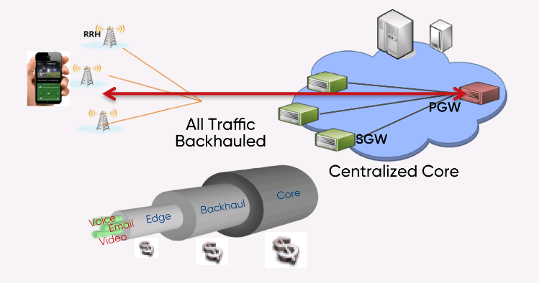

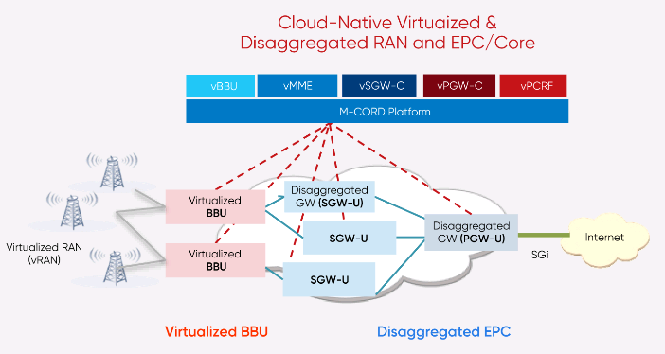

What is CORD?
Current
Future

Slide 33


CORD DEMO
Multiple LTE Providers:
    Private tactical (Elbit)
    Private Commercial (ASOCS)
    Public Commercial (Partner)
eNB1
Designed for LSO interface
Private Tactical
T
A
c
T
A
c
Elbit
M-CORD-T
eNB2
Policy
Server
Public
ASOCS
M-CORD O-RAN
1
RRH
Content
Server
2
3
RH
PARTNER
PUBLIC 4G/5G

Slide 34




M-CORD-T (M-CORD in a small box)
eNB1
Private Tactical
T
A
c
T
A
c
Elbit
M-CORD-T
eNB2
Standalone LTE system

Slide 35
Transport Aware Service
UE
LTE
1
eNB1
UE
LTE
Designed for LSO interface
Private Tactical
2
T
A
c
T
A
c
Elbit
M-CORD-T
eNB2
Policy
Server
UE
LTE
Public
3
ASOCS
M-CORD O-RAN
1
RRH
Content
Server
2
PARTNER
PUBLIC 4G/5G
3
RRH

Slide 36
What did we want to accomplish?
When we started Neptune 5 years ago, our vision included:
reduction of service setup time from months to minutes
automation of network operations, including
  zero-touch instantiation of network elements and services
  automatic resilience and self-healing
operational expense reduction of 50% or more
enabling completely new service types
building an Israeli ecosystem for the next generation of networking
In the past two years we extended these same goals for services:
  spanning multiple network operators (Lifecycle Service Orchestration)
  requiring an independent subnetwork (network slicing)

Slide 37
Self Healing
Presenter: Doron Solomon (ASOCS)

Slide 38
Self-Healing Plus!
Demonstrate Multi LTE Providers:
    Private Commercial (ASOCS)
    Public Commercial (Partner)
F1 is allocated for the Private Net
F2 is allocated for the Public Net
    Demonstrate available BW provided using a
    Smartphone while connected to each of the Nets
The Public network is malfunctioning
    Demonstrate automatic reconfiguration of the Private network while allocating it F1+F2
    Demonstrate the increase of available BW using a Smartphone

Slide 39

Self Healing Plus! – phase 1
LSO interface
X
Orchestration
Server
F1
Private Commercial
Measure
Available BW
RRH
ASOCS
M-CORD
O-RAN
F2
Public
ENB/RRH
PARTNER
PUBLIC 4G/5G
Measure
Available BW

Slide 40
Self Healing Plus! – phase 2
LSO interface
Orchestration
Server
F1
Private Commercial
Measure
Available BW
RRH
ASOCS
M-CORD
O-RAN
F2
Public
ENB/RRH
PARTNER
PUBLIC 4G/5G
Measure
Available BW

Slide 41
Satellite Self Healing
Presenter: Avi Gal (GIlat)

Slide 42
Satellite Self healing Weather Criterion
Predicted bad weather information.
Module Failure - Failure of more than one module at any one site Datacenter or Gateway
Signal Degradation
  The following criteria shall be examined to determine signal degradation:
    Beacon Reception strength at Gateway
    Reception power at VSAT
    Reception power at Gateway

Slide 43
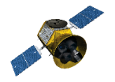

Satellite Self healing
3 teleport, 2 VSNs using shared baseband, each VSN has different diversity teleport
Single shared DC serving both VSNs
Teleport C
DC+ Teleport A
Baseband-chassis
Baseband-chassis
DC-x86 NFs
Teleport B
RFC_A
RFC_B
Baseband-chassis
SDN-C
SAT-MANO
SAT-CTLR

Slide 44
Satellite Self healing
Both RF, Network and DC are re-programmed
Teleport C
DC+ Teleport A
Baseband-chassis
Baseband-chassis
DC-x86 NFs
Teleport B
Fade sensor
RFC_A
RFC_B
Baseband-chassis
SDN-C
Self healing app
SAT-MANO
SAT-CTLR

Slide 45
Satellite Self healing
Teleport C
DC+ Teleport A
Baseband-chassis
Baseband-chassis
DC-x86 NFs
Teleport B
sensor
RFC_A
RFC_B
Baseband-chassis
SDN-C
Self healing app
SAT-MANO
SAT-CTLR

Slide 46
What did we want to accomplish?
When we started Neptune 5 years ago, our vision included:
reduction of service setup time from months to minutes
automation of network operations, including
  zero-touch instantiation of network elements and services
  automatic resilience and self-healing
operational expense reduction of 50% or more
enabling completely new service types
building an Israeli ecosystem for the next generation of networking
In the past two years we extended these same goals for services:
  spanning multiple network operators (Lifecycle Service Orchestration)
  requiring an independent subnetwork (network slicing)

Slide 47
P4 and Sampling on Demand
Presenter: Itzik Ashkenazi (Technion)

Slide 48
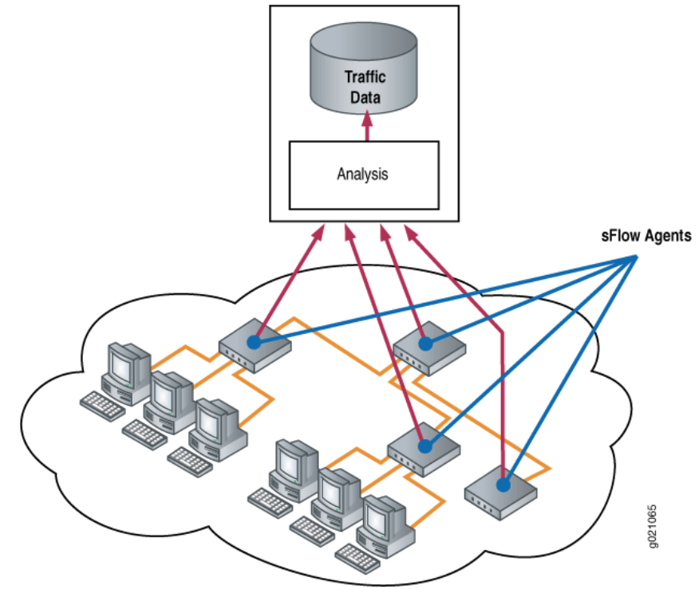
Uniform Packet Sampling
Each switch samples packet at a predetermined rate
The sampling rate is usually determined
while taking into account the link speed
Common implementation
includes sFlow and NetFlow
Notes:
For example, in sFlow there is a table for recommended sampling rate for different link speeds.

Slide 49
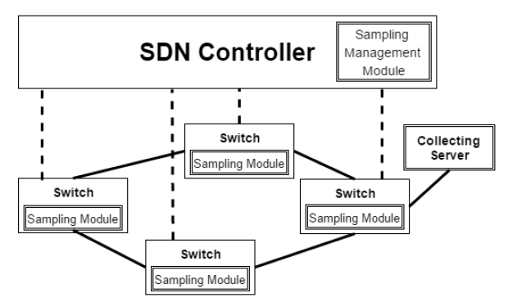
The Proposed Framework
Sampling Management Module (SMM)
  An SDN controller application.
  Determines the sampling rate of each flow at each
  Switch according to the monitoring goals of the network
  operator, while taking into account the monitoring
  capabilities of each switch.
Sampling Module
  Added to some or all network switches/routers.
  Encapsulates each sampled packet in a UDP packet and sends it to a collecting server.
  Configured with an IP of a collecting server.
Collecting Server
  One or more are located in the network in order to collect and process the sampled packets.

Slide 50
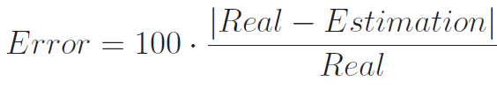
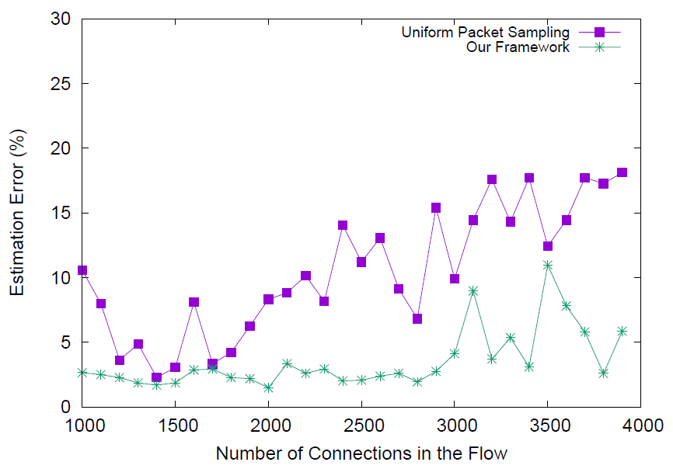
Estimating Number of Connections
We define 30 [source, destination] flows in the network, each carries a different number of connections from a client to a random server
In each experiment, we calculate the estimation percentage error for each flow:
Using our framework we achieve a smaller estimation error
In most cases the error in our framework is around 2.5%, while without our framework it is typically around 10%
Notes:
Each client sends packets at a total rate of 100pps.

Slide 51
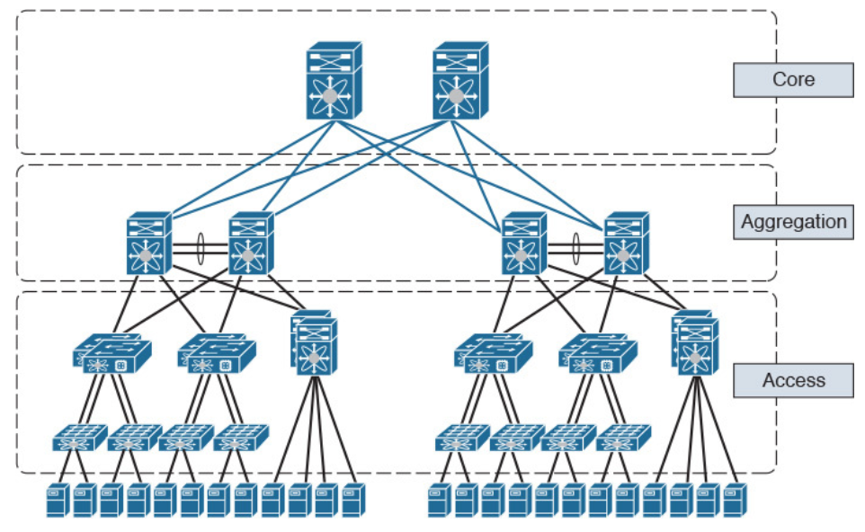
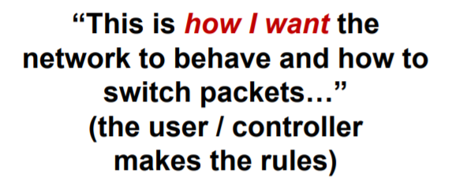
Programmable Device: Top-Down Design
Switch OS
Network Demands
Run-Time API
Driver
P4
P4 Programmable Device

Slide 52
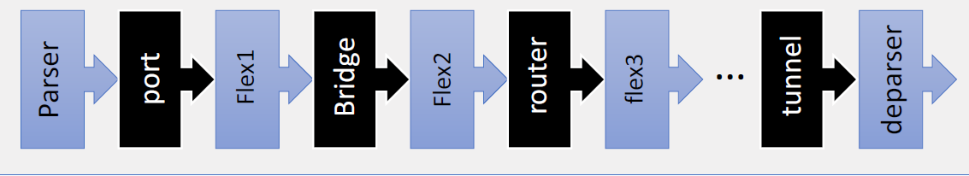
P416 Architectures
                Mellanox-Hybrid
Targets: Spectrum-2
Notes:
Protocol Independent Switch Arch

Slide 53

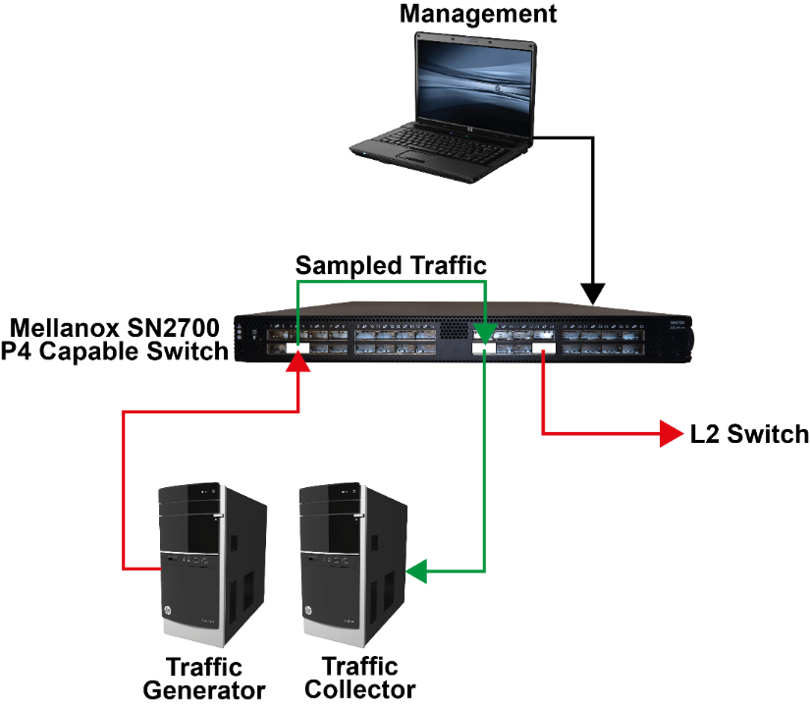

SoD with GRE encapsulation
table table_mirror {
key = { standard_metadata.ingress_port : exact;
headers.ip.v4.hdr_checksum : ternary;
}
actions = { NoAction; DoMirror; }
default_action = NoAction();
}
Key | Action | Action Data
ingress port = 7, checksum = 0x1&0x3 | Mirror | MirrorSessionID
Notes:
As u can see there is almost no deference with the previous slide. But now we have GRE tunnel.
Preprocessing configurations for GRE encapsulation implamentation – span session
We added the encapsulation directly as a part of the span session, as a setup parameter to the mirroring.

Slide 54
Neptune Summary
Presenter: Yaakov Stein (Neptune)

Slide 55
Reminder – what is Neptune ?
Neptune = the Israeli Consortium for Network Programming
Until recently the world of networking was split in two:
Internet type networks – inexpensive, dynamic, best effort
Carrier Grade networks – expensive, static, strong SLA guarantees (high availability, low loss, low delay)
What the world needs now is the best of both worlds!
inexpensive
high data rate
highly dynamic
strong QoS guarantees
What the world needs now is Neptune!

Slide 56

חברי מאגד נפטון - שנה ה'
8 מוסדות מחקר
ספק שרותי תקשורת
9 ספקי ציוד תקשורת

Slide 57
How does Neptune work ?
Neptune’s 5 years of research was based on two technologies:
SDN – Software Defined Networking
intelligence in centralized servers, rather than distributed routing
more dynamic, flexible, and automatic network functionalities
more efficient and cost-effective operations
NFV – Network Functions Virtualization
hardware network elements virtualized - replaced by software
virtualized functionalities run on standard computational platforms
zero-touch installation, relocation, configuration, upgrade
Together these technologies make the network programmable
replace “distributed protocols”
with Application Programming Interfaces
to centralized servers
replace “network equipment” (boxes)
with Virtualized Network Functions
running on Commercial Off The Shelf servers

Slide 58
Neptune changed the world
Numerous innovations first proposed in Neptune
were subsequently adopted word-wide
vCPE (distributed NFV)
Lifecycle Service Orchestration implementation
VNF hardware acceleration
OpenStack orchestration of hardware services
SDN for tactical radio networks
DPIaaS, Proof of Transit extensions
Many new SDN/NFV optimization algorithms
Several new SDN platforms
>60 innovative academic papers

Slide 59
What did we want to accomplish?
When we started Neptune 5 years ago, our vision included:
reduction of service setup time from months to minutes
automation of network operations, including
  zero-touch instantiation of network elements and services
  automatic resilience and self-healing
operational expense reduction of 50% or more
enabling completely new service types
building an Israeli ecosystem for the next generation of networking
In the past two years we extended these same goals for services:
  spanning multiple network operators (Lifecycle Service Orchestration)
  requiring an independent subnetwork (network slicing)

Slide 60

Academic papers
In 5 years Neptune has produced over 60 papers
list of papers

Slide 61

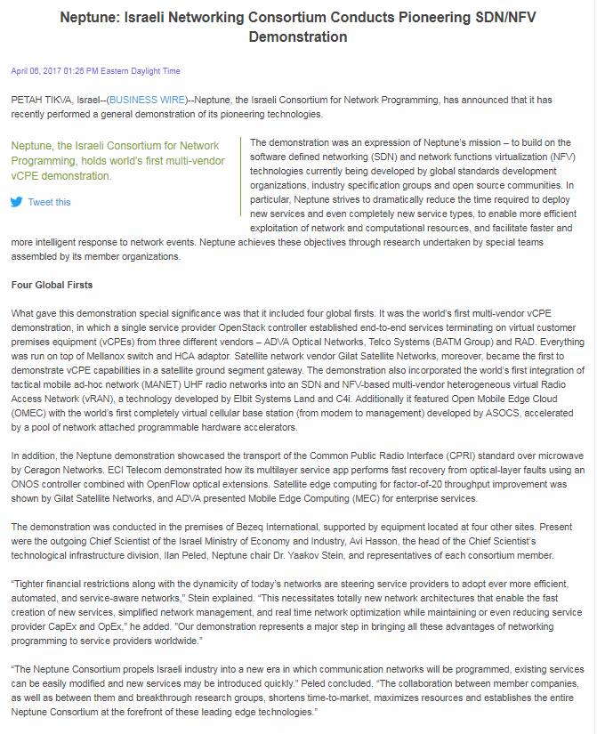
Our previous demo
We previously demoed many innovations:
multi-vendor vCPE
virtual base station
CPRI over microwave
MEC-based local breakout
1-way delay via a virtual clock
VNF acceleration
optical network optimization
SDN routing algorithms

Slide 62
השקעת הרשות בנפטון
השנה | תעשייה | אקדמיה
שנה א | 13,248,881 | 2,876,319
שנה ב | 15,416,280 | 3,107,966
שנה ג | 15,383,885 | 2,890,724
שנה ד | 12,568,888 | 2,724,282
שנה ה (*) | 8,353,397 | 1,480,863
סה"כ | 64,971,331 | 13,080,154
הסכומים של שנה ה' הינם עד וכלל הרבעון השלישי (בלי מרכיב המקדמה אשר ברבעון הקרוב יבוטל לגמרי)

Slide 63
תחזיות
תחזית המוצרים כתוצאה ממחקרי נפטון
כל חברות המאגד דיווחו על מוצרים המתוכננים במפות הדרכים במהלך 2019-2020 המבוססים על טכנולוגיות שפותחו במאגד
תחזית מכירות ל-5 שנים
תחזית במכירות מבוססת על תחזית שנמסרה מ-8 מחברות התעשייה
המכירות הצפויות מהמוצרים המבוססים על טכנולוגית נפטון הוא 5,620,120,000 ₪ (פירוט התחזית נמסר לרשות)
יחס מכירות להשקעת הרשות הינו יותר מפי 70

Slide 64
Multi-operator multi-technology service creation
Presenter: Yitzhak Aizner (ECI)

Slide 65
Story: LSO demo
User of Operator A is located at the reach area of Operator C
Using the user portal of Operator A the user is asking Operator A to stream video to its TV Screen (located at Operator C area)
Using Sonata, Operator A find the intercarrier path to Operator C (via Operator B)
Using Presto, the required ENNIs are interconnected and the video is being streamed
The ENNI can be demonstrated over each underlying infrastructure
that is, P2P MW Radio, Satellite, Cellular, etc.

Slide 66
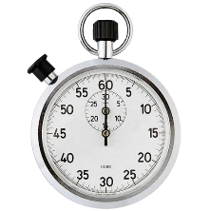

Our Goal
90
90
days
seconds

Slide 67












What’s the problem?
90
Customer Care
days
Business
Business
Business
Business
Operations
Operations
Operations
Operations
controller
NMS
controller
NMS
controller
NMS
controller
NMS
MANO
MANO
MANO
MANO
Headquarters
Branch Office
Tel-Aviv
Hong Kong

Slide 68

Internal OSS/BSS chasm
No standards for automation
Establishment of a new service takes weeks
So, that’s 20 megs for 6 months starting in June, Right?
No, my app needs 100 megs now for the next 2 hours!!!!
BSS/OSS Chasm

Slide 69



What’s the solution?
90
Customer Care
Std. API
seconds
Std. API
Std. API
Std. API
Business
Business
Business
Business
Std. API
Std. API
Std. API
Std. API
Std. API
Std. API
Std. API
Operations
Operations
Operations
Operations
Std. API
Std. API
Std. API
Std. API
controller
NMS
controller
NMS
controller
NMS
controller
NMS
MANO
MANO
MANO
MANO
Headquarters
Branch Office
Tel-Aviv
Hong Kong

Slide 70
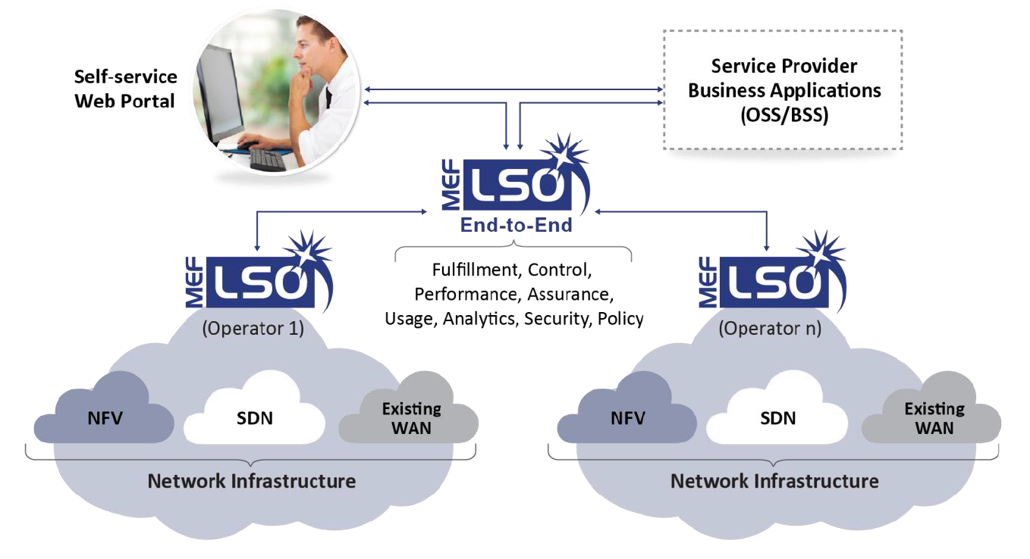
LSO = OSS/BSS + Automation & standardization
  LSO is intended to replace most of the OSS/BSS functionalities
  LSO enables automatic E2E service operation & maintenance across multiple SPs
  LSO’s standard interfaces, and its unified information model will enable multi-vendor support across all network layers
LSO is actually an automatic multi-vendor multi-operator OSS/BSS
- with standard interfaces among components -

Slide 71
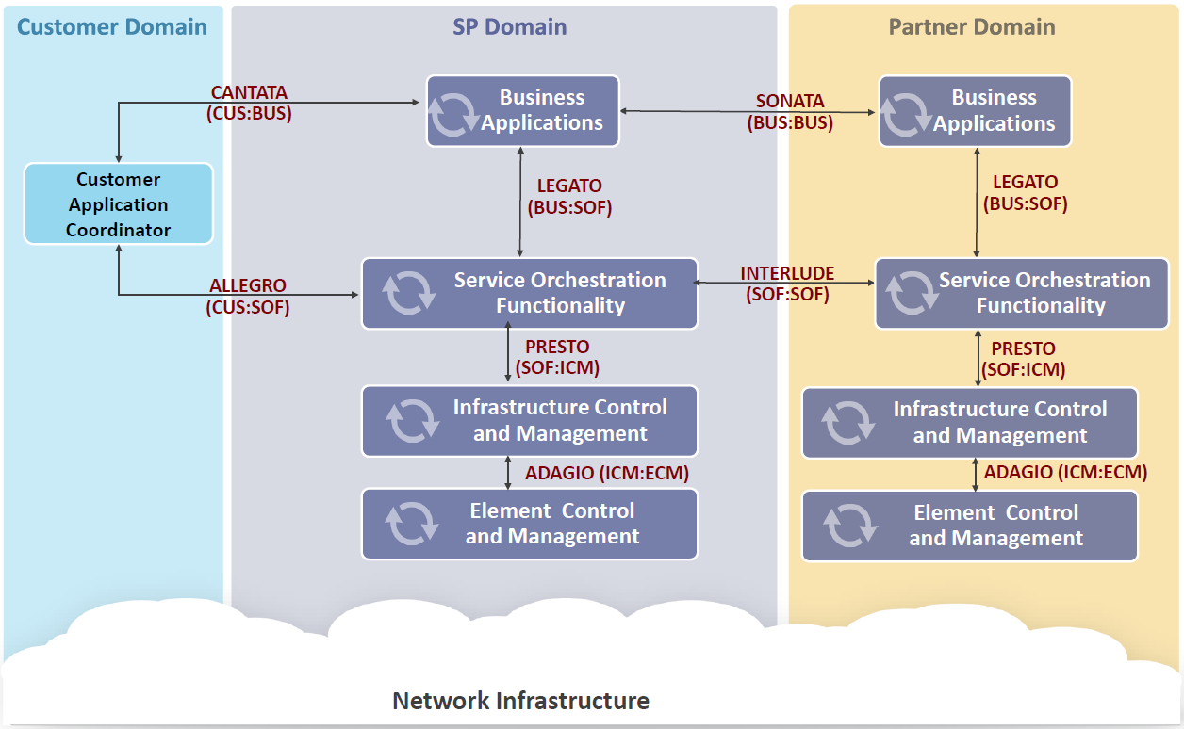
MEF LSO reference architecture

Slide 72
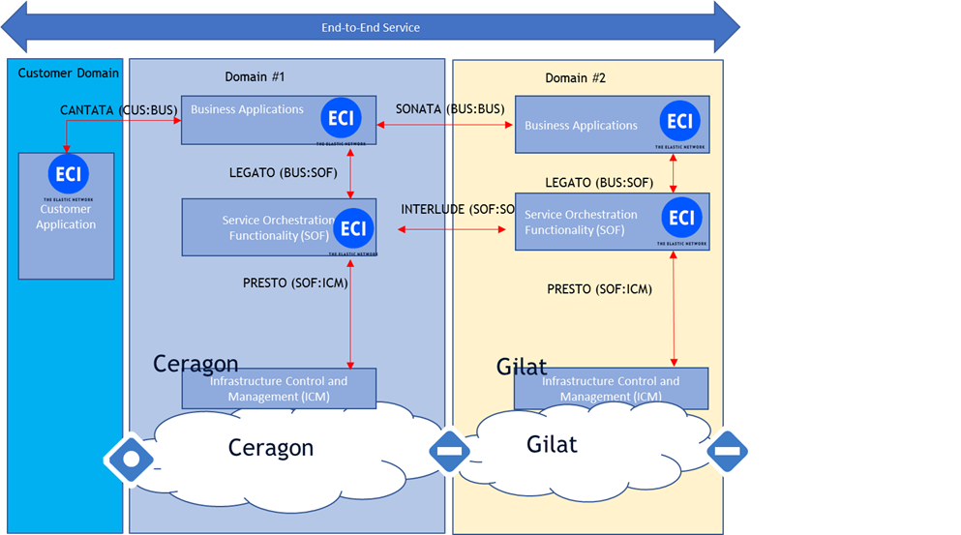
The demo

Slide 73



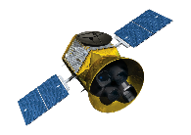
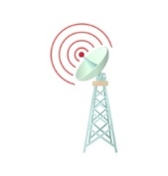

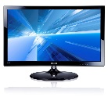


The demo
Cantata
User of
Operator A
User
Portal
LSO
Framework
LSO
Framework
Sonata
Presto
Presto
ENNI
Video
Streamer
Video
Screen
Operator A
Operator B

Slide 74

Ready, set, go!

Slide 75
What did we want to accomplish?
When we started Neptune 5 years ago, our vision included:
reduction of service setup time from months to minutes
automation of network operations, including
  zero-touch instantiation of network elements and services
  automatic resilience and self-healing
operational expense reduction of 50% or more
enabling completely new service types
building an Israeli ecosystem for the next generation of networking
In the past two years we extended these same goals for services:
  spanning multiple network operators (Lifecycle Service Orchestration)
  requiring an independent subnetwork (network slicing)

Slide 76
Satellite and Microwave Network Slicing
Presenter: Zafi Kariv (Elbit)

Slide 77
Story: Network slicing
Mobile operator with Critical infra/security customer
explain what a slice is and show slice creation
show slice policy and how application can modify needs if slice falls
color movie changes to monochrome
show how congested slice doesn’t impact other
Gilat satellite slicing demo

Slide 78
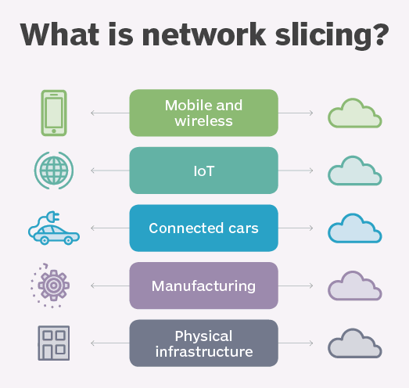
What is Network Slicing?
Network slicing is the separation of multiple virtual networks that operate on the same physical hardware
for different applications, services or purposes
Each network slice has its own architecture,
provisioning management, security, speed,
capacity, connectivity and coverage
to support its particular use case

Slide 79











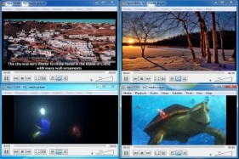
Links – Network Slicing
LSO
Policy
Server
SDN Controller:
Faucet (RYU)
Satellite Radio
Slice 1
Slice 2
Slice 3
Slice 4
Video Client
Traffic Generation :
4 video streams over 4 slices
Slice 1
Slice 2
Micro Wave Radio
Slice 3
Slice 4
Video Client

Slide 80
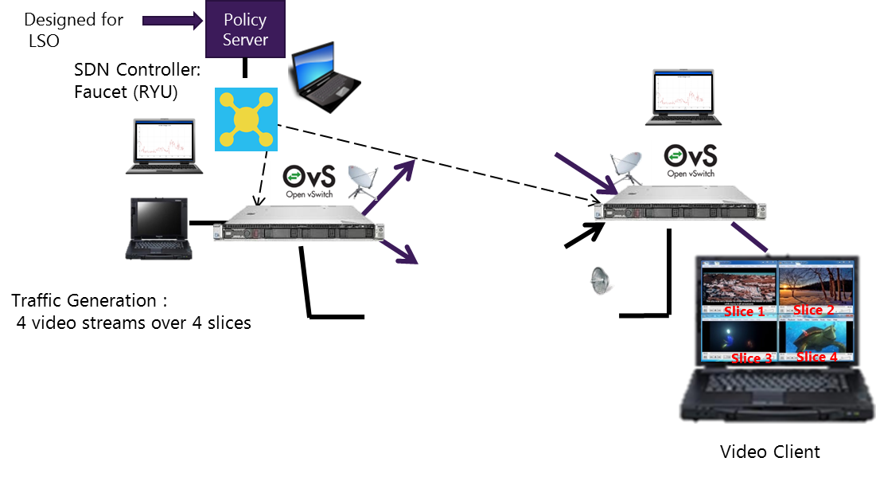
SDN and policy control
SDN Controller
  Faucet (RYU)
Policy server
    Reactive
    Proactive
LSO
Video sources & traffic analysis

Slide 81
Network Slice Isolation
Orchestrator
REST Conf
SDN controller
NetConf
NE 1
NE 2
NP
RADIO
RADIO
NP
OVS
Slice 1
Slice 1
OVS
Slice 2
Slice 2
Ethernet
Ethernet
Slice 1:
SLA: 500 Kbit/s Bi-Directional Constant Bit Rate, Jitter <20ms, Delay <800ms
Slice 2:
SLA: Best Effort Service

Slide 82
Cellular Network Slicing
Presenter: Doron Solomon (ASOCS)

Slide 83
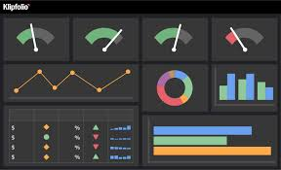
Cellular network slicing and KPIs
Designed for LSO interface
Slice A
Orchestration
Server
Private Mobile Service
S.P
RRH
ASOCS
M-CORD O-RAN
Measure
Available BW
F2 Service
Public Mobile Service
S.P
ENB/RRH
PARTNER
PUBLIC 4G/5G
Orchestration
Server
Measure
Available BW
F1 Service
Slice B

Slide 84
What did we want to accomplish?
When we started Neptune 5 years ago, our vision included:
reduction of service setup time from months to minutes
automation of network operations, including
  zero-touch instantiation of network elements and services
  automatic resilience and self-healing
operational expense reduction of 50% or more
enabling completely new service types
building an Israeli ecosystem for the next generation of networking
In the past two years we extended these same goals for services:
  spanning multiple network operators (Lifecycle Service Orchestration)
  requiring an independent subnetwork (network slicing)

Slide 85
Summary Remarks
Presenter: Yaakov Stein (Neptune chair)

Slide 86
What did we see today?
We presented a series of demos
demonstrating that we have achieved our aims
These demos will involved
7 interconnected networks
6 technologies
corporate network / Internet
optical network (ECI)
microwave links (Ceragon)
satellite links (Gilat)
tactical network (Elbit)
public 4G network (Partner)
private 4G network (ASOCS)

Slide 87
What did we want to accomplish?
When we started Neptune 5 years ago, our vision included:
reduction of service setup time from months to minutes
automation of network operations, including
  zero-touch instantiation of network elements and services
  automatic resilience and self-healing
operational expense reduction of 50% or more
enabling completely new service types
building an Israeli ecosystem for the next generation of networking
In the past two years we extended these same goals for services:
  spanning multiple network operators (Lifecycle Service Orchestration)
  requiring an independent subnetwork (network slicing)

Slide 88
Academic Session

Slide 89
Academic Poster session
Technion: Reuven Cohen
Technion: Isaac Keslassy
Technion: Naor + Orda
BGU: Shlomi Dolev
BGU: Michael Segal
BGU: Cohen, Gurewitz and Scalosub
TAU: Patt-Shamir + Even + Medina
Lev+Ariel: Dvir
Technion: Emek-Kutten

